Slide 1
Monthly Update on 2018-2019 WRAP Workplan October 30th, 2019 TSC and Work Group Co-Chairs Call
Tribal Data WG
Fire and Smoke WG
Oil and Gas WG
Regional Technical Operations WG
Regional Haze Planning WG

Slide 2
Tribal Data Work Group

Slide 3
Workplan Progress by Tribal Data Work Group
Workplan Progress over the Last 2 Months* (Oct mtg cancelled)
EN3 finalized, distributed to TDWG final tribal contacts list with “active tribes”
Emissions Inventories Evaluation- Tribal Oil & Gas final report (august)
Workplan Tasks for the Next Two Months
Finalize EI Evaluation (Tribal Oil & Gas) – distribution to subject tribes, OGWG
Planning call for WRAP webpage/maps, TSS v2, IWDW webinar with ITEP
Send TDWG participation letter – via WRAP staff/WRAP web service

Slide 4
Workplan Coordination Activities by Tribal Data Work Group
Workplan Coordination Occurring over the Last Month
1st planning call for webinar
Workplan Coordination Needed over the Next Two Months
Distribute EN3’s EI Evaluation to OGWG (2 week turnaround)
Webinar – planning calls, webinar scheduled for Dec 4th, 10 am MST

Slide 5
Fire and Smoke Work Group

Slide 6
Workplan Progress by Fire and Smoke Work Group
Workplan Progress over the Last Month
Submitted Representative Baseline Fire EI to Ramboll
Reviewed Future Fire Scenarios plan for sensitivity runs
2 runs: wildfire FFS and Rx FFS
Workplan Tasks for the Next Two Months
Finalize and approve FFS approach
Execute FFS approach and deliver scenarios to Ramboll by 12/4/19
Collect and collate data for SMP survey
Add SMP survey data to WRAP map

Slide 7
Workplan Coordination Activities by Fire and Smoke Work Group
Workplan Coordination Occurring over the Last Month
Held an RBFFS call
Ralph Morris of Ramboll attended call
Workplan Coordination Needed over the Next Two Months
Mark Fitch will be coordinating with federal Rx burners to fill in a matrix of % increases in Rx burning by agency and region – Matt will scale the Rx FFS based on this matrix

Slide 8
Oil and Gas Work Group

Slide 9
Workplan Progress by Oil and Gas Work Group
Workplan Progress Over the Last Month
OGWG and Project Management Team (PMT) review and feedback
Forecast (OTB & OTW) Inventory “Continuation of Historical Trends” – Complete
Final Report and Inventory Spreadsheet including controls analysis
SMOKE-inputs developed for WRAP Modeling and 2016 Emissions Platform Collaborative
Tasks 2, 3, 4 – Underway
Workplan Tasks for the Next Two Months
Task 2: Forecast 2028 Inventory (OTB & OTW) – November
“Reduced Legacy Well Activity” and “Increased Horizontal Well Activity” Scenarios
No additional controls analysis
Task 3: Forecast 2028 Inventory (Additional Reasonable controls) – End of 2019
Methodology by which emission control estimates may be made by regulatory agencies
Task 4: Agency Program Review Task – End of 2019
Emphasis on describing state programs with agency input

Slide 10
Workplan Coordination Activities by OGWG
Workplan Coordination Occurring Over the Last Month
October 1 – OGWG Webinar Midterm Update
October 8 – OGWG Bi-Monthly Call
October 15 & 30 – Project Management Team Calls
Coordinate and PMT feedback with Ramboll
Workplan Coordination Needed Over the Next Two Months
Nov. 12 – Project Management Team Call
Dec. 10 – OGWG Bi-Monthly Call
OGWG and PMT review and feedback on draft work products
Mid-November: Forecast Scenarios Draft Final Report (3 scenarios included) & Spreadsheets
November: Additional Reasonable Controls Report/Memo
November: Agency Input to describe state programs
Coordination with RHPWG Control Measures Subcommittee
Coordination (External to WRAP) Occurring / Needed
EPA’s 2016 Modeling Platform Collaborative – availability of OGWG baseline & future inventory
2017 NEI – account for inventory improvements

Slide 11
Regional Technical Operations Work Group

Slide 12
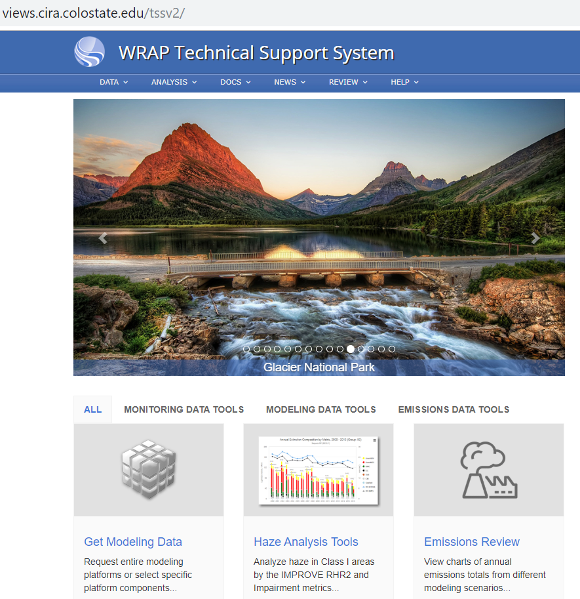
Workplan Progress by RTOWG
Workplan Progress over the Last Month
2014v2 base case simulation underway
Presentation on “Modeling: International vs. US Contributions” at RHPWG ‘Octoberfest’ (10/3)
Dynamic model evaluation scoping study
Representative baseline EGU profiles
Discussion of WRAP TSS2 analyses and graphics (10/17)

Slide 13
Workplan Progress by RTOWG
Workplan Tasks for the Next Two Months
Finish 2014v2 CAMx base case run
Abbreviated fire plume rise sensitivity run
GEOS-Chem/CAMx International Emissions (ZROW and Natural runs)
Broad-Based Anthro vs. Natural PM Source Apportionment run
Representative Baseline Emissions and PGM Modeling
2028 Mobile Source and O&G Emissions Projections
2028 OTB/OTW Modeling and Visibility Projections
Analysis of OAQPS 2016 beta’ Regional Haze Modeling Platform & 2028 Visibility Projections

Slide 14
Workplan Coordination Activities by RTOWG
Workplan Coordination Occurring over the Last Month
Coordination with Ramboll on modeling progress (10/3, 10/10, 10/17)
Monthly RTOWG call (10/15) – discussion on modeling products and updates on schedule
EPA webinar on 2028 modeling (10/15)
HAQAST ozone (10/2) and haze (10/17) monthly calls
Calling in for OGWG (10/1), RHPWG (10/17)
Bi-weekly RTOWG co-chair coordination calls

Slide 15
Workplan Coordination Activities by RTOWG
Workplan Coordination Needed over the Next Two Months
Extended RTOWG meeting in November (11/19) – discuss 2014v2 results
Emission inventory updates for 2028: mobile, EGU’s
Coordination calls with Ramboll for completion of Phase III modeling deliverables and preparing for Phase IV
Preparation of representative baseline emissions
HAQAST ozone and haze calls

Slide 16
Regional Haze Planning Work Group

Slide 17
Workplan Progress & Coordination by Regional Haze Planning Work Group
Workplan Progress and Coordination over the Last Month
October 3rd Milestone Webinar
Review of EPA’s Regional Haze Guidance
Workplan tasks and Coordination for the Next Two Months
Development of Regional Haze in the West Storyboard
Coordinate ongoing discussions of controls and modeling – both require states to consult with sources
WESTAR/WRAP Fall Business Meeting

Slide 18
Workplan Progress by Control Measures Subcommittee
Workplan Progress over the Last Month
Call was held on September 23rd
States in various stages of 4-factor analysis work
Workplan Tasks for the Next Two Months
Next call October 31st –
Plan to discuss BART/RP controls and costs from Round 1 WRAP RH SIPs
Continue discussion on determining remaining useful life for EGUs considering retirement

Slide 19
Workplan Coordination Activities by Control Measures Subcommittee
Workplan Coordination Occurring over the Last Month
Participate on monthly O&G Workgroup calls
Workplan Coordination Needed over the Next Two Months
Continue to coordinate with O&G work group and Emission Inventory Subcommittee on emission forecasts.

Slide 20
Workplan Progress by Coordination and Glide Path Subcommittee
Workplan Progress over the Last Month
Elevated Coordination Framework to RHPWG -> TSS
Review of TSS FAQ Document & TSS Glossary
TSSv2 Deliverables and New Products Presentation
Overview of outstanding tasks
Workplan Tasks for the Next Two Month
Continue overview of TSSv2 development
Elevate FAQ and Glossary to RHPWG
Revisit TSS Priorities document
Mockup presentation of storyboard

Slide 21
Workplan Coordination Activities by Coordination and Glide Path Subcommittee
Workplan Coordination Occurring over the Last Month
The subcommittee coordinated with the following entities:
TSS – Elevated Coordination Framework for Consensus
Workplan Coordination Needed over the Next Two Months
RTOWG – Coordination on Natural Conditions Project findings and opportunities to model outcomes for future planning periods.
RTOWG – TSS Priorities for Modeling/EI

Slide 22
Workplan Progress by EI&MP Subcommittee
Workplan Progress over the Last Month
Provided contractor with Representative Baseline emissions from states
Received projection methodology for mobile sources (EPA Modeling Platform)
Workplan Tasks for the Next Two Months
Obtain future facility emissions from states/locals and deliver to contractor.
2028 OTW/OTB and Controls scenarios
Contractor to start Rep. Baseline and OTW/OTB simulations

Slide 23
Workplan Coordination Activities by EI&MP Subcommittee
Workplan Coordination Occurring over the Last Month
Coordinated with contractor to review 2016 Modeling Platform release
Workplan Coordination Needed over the Next Two Months
Representative baseline and future modeling scenarios require coordination as needed with O&G WG, contractor, Fire & Smoke WG,
Coordinate with C&GP subcommittee to provide guidance to states on what is needed from them for the different modeling scenarios

Slide 24
End of Workplan Progress Update

